Slide 1
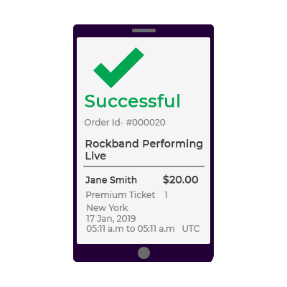



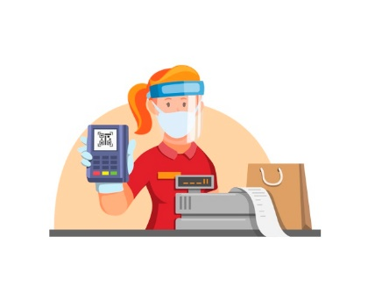



Menu
Cart
Checkout
Opens web app
placeOrder(itemList)
checkInventoryStatus (productId)
return Status
Fully responsive
High Performance
Light weight
Offline mode
Connectivity Independence
getMenu (restaurantid)
Temporary DB
Pub/Sub
POS server
Counter staff confirms order
CDN
Pay and collect order
Progressive Web App Architecture

